Slide 1
Was Abraham Lincoln “Democratically Elected”?

Slide 2
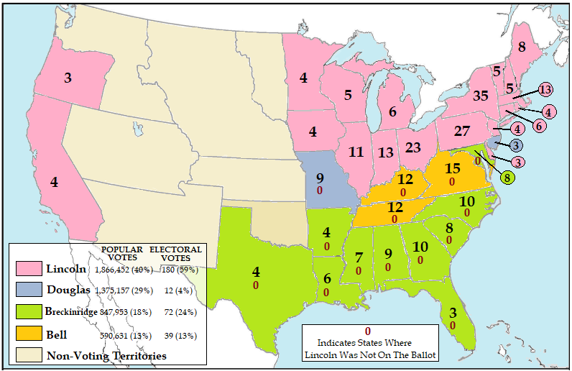

Slide 3
Was Abraham Lincoln “Democratically Elected?
Use the information from the map to answer the following questions:
Which candidate had the most popular votes?
Which candidate had the most Electoral votes?
What arguments could that candidate use to make the case he was the democratically elected president?

Slide 4
Was Abraham Lincoln “Democratically Elected?
Use the information from the map to answer the following questions:
What was the total number of popular votes for the other three candidates?
What was the total number of Electoral votes for the other three candidates?
What arguments could be made that candidate who won was not the democratically elected president?

Slide 5
Was Rutherford B. Hayes “Democratically Elected”?

Slide 6
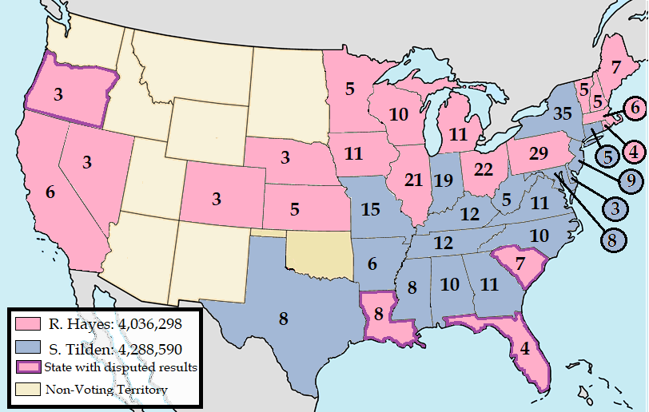

Slide 7
Was Rutherford B. Hayes “Democratically Elected?
Use the information from the map to answer the following questions:
Which candidate had the most popular votes?
What arguments could that candidate use to make the case he was the democratically elected president?
Which candidate had the most Electoral votes?
What arguments could that candidate use to make the case he was the democratically elected president?

Slide 8
Was Rutherford B. Hayes “Democratically Elected?
Use the information from the map to answer the following questions:
How many states had disputed elections?
Three of the four states were in which region of the country? Why is that significant?
How would the election have been different if those three states had their Electoral Votes assigned to the other candidate?

Slide 9
Was Rutherford B. Hayes “Democratically Elected?
Use the information from the linked article to answer the following questions:
https://millercenter.org/the-presidency/educational-resources/disputed-election-1876
Describe the purpose of the Electoral Commission Act and evaluate its effectiveness in producing in a democratic outcome.
Evaluate whether the actions taken by Congress to resolve the disputed Electoral Vote reinforced or undermined the principles of popular, democratic election.

Slide 10
Election Statistics From
https://www.presidency.ucsb.edu/statistics/elections/1860
https://millercenter.org/the-presidency/educational-resources/disputed-election-1876

