Slide 1
Was John Quincy Adams “Democratically Elected”?

Slide 2
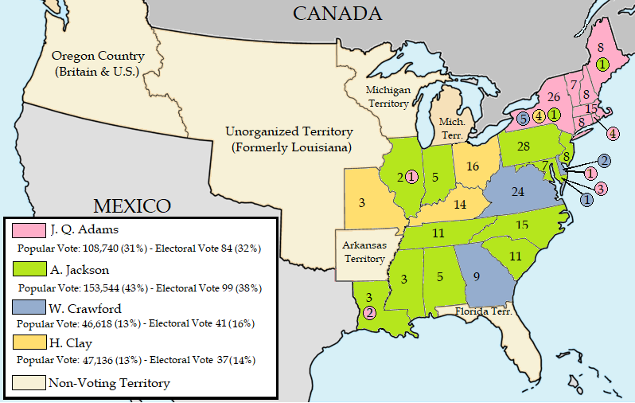

Slide 3
Was John Quincy Adams “Democratically Elected?
Use the information from the map to answer the following questions:
Which candidate had the most popular votes?
Which candidate had the most Electoral votes?
Which candidate had support in all three sections of the country (Northeast, South, and West)?
What arguments could that candidate use to make the case he was the democratically elected president?

Slide 4
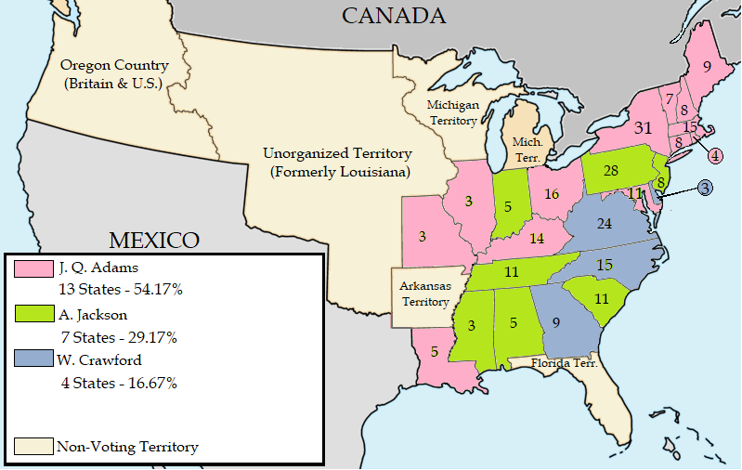

Slide 5
Was John Quincy Adams “Democratically Elected?
Use the information from the map to answer the following questions:
Which candidate won the most state votes in the House of Representatives?
What arguments could that candidate use to make the case he was the democratically elected president?
How did the results of the election support the argument that the Presidency is a democratic institution?
How did the results of the election undermine the argument that the Presidency is a democratic institution?

