Slide 1
Jeffersonian Democracy vs. Jacksonian Democracy
COMPARE & CONTRAST

Slide 2
Jeffersonian Democracy vs. Jacksonian Democracy
Use your knowledge of the early national period to identify traits of Jeffersonian Democracy and Jacksonian Democracy as well as traits that the two visions of American government shared.
Use the information in the Venn Diagram and your evaluation of the historical evidence to respond to the follow-up questions on the competing visions of the Presidency as a democratic institution.

Slide 3
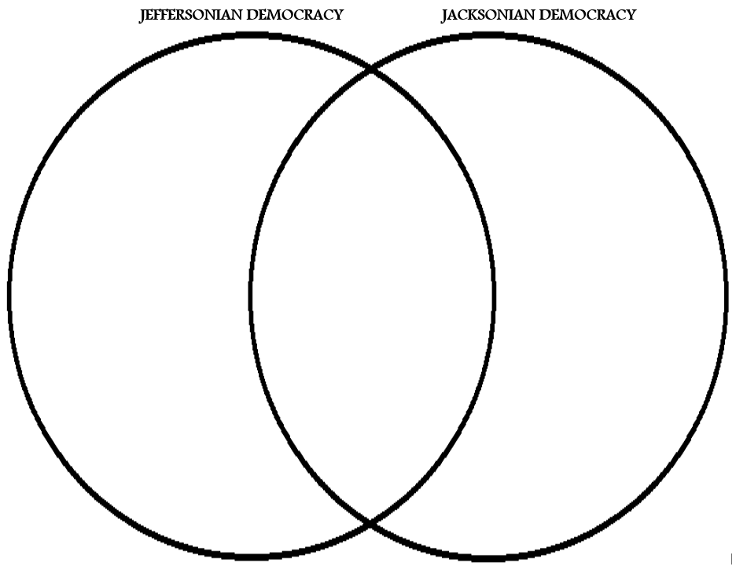

Slide 4
Jeffersonian Democracy vs. Jacksonian Democracy
- “Rise of the Common Man”
- Education
- Andrew Jackson
- “Spoils System” (Political Rewards)
- 1800-1820s
- Strong Chief Executive
- James Madison
- Conflict with John Marshall over Federal Authority
- “Aristocracy” based on merit and skill
- Pro-Slavery
- James K. Polk
- Universal White Male Suffrage (No Property Requirement)
- Candidate Selection through political convention
- Influenced by Enlightenment philosophy
- Second Great Awakening
- States’ Rights Advocate
- Candidate selection by caucus
- “Gentleman Farmer”
- Anti-Education
- Thomas Jefferson
- All white males equal
- James Monroe
- “Virginia Dynasty”
- Distrust of Banks
- Elevate citizens (White Males) through public education
- Martin van Buren
- No “Aristocracy”
- 1830s-1840s
- Native Americans not Citizens

Slide 5
Jeffersonian Democracy vs. Jacksonian Democracy
How do you think Jefferson would have defined “democratic government”?
How do you think Jackson would have defined “democratic government”?

Slide 6
Jeffersonian Democracy vs. Jacksonian Democracy
Do you think Jefferson saw the Presidency as a “democratic” institution? What specific, historical evidence can you use to support your theory?
Do you think Jackson saw the Presidency as a “democratic” institution? What specific, historical evidence can you use to support your theory?

