Slide 1

OPENER
Who Are You?
We’ll Discuss:
What does it mean to study demographics?
***
How is the U.S. population changing?
***
How is the Census used?
Brainstorm:
What parts of your identity are important to you?
Some aspects of your identity may be unique to your own interests and activities. Others might connect to demographic characteristics – ways that people who study the population group different people within it.

Slide 2
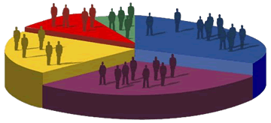
DEMOGRAPHICS
Learning About the Population
One definition of demographics:
Data relating to a population and particular groups within
it

Slide 3

DEMOGRAPHICS
Learning About the Population
Big Questions:
How are we dividing up the population into groups?
What do we want to know about those groups?

Slide 4
DEMOGRAPHICS
Learning About the Population
First question:
How are we dividing up the population into groups?
ON WHAT
DEMOGRAPHIC CHARACTERISTIC DO WE FOCUS? AND HOW DO WE USE IT TO GROUP PEOPLE?
ONE EXAMPLE
Demographic Characteristic: Age
Groups we could compare: * Americans between 18-29
* Americans 60 and over

Slide 5
DEMOGRAPHICS
Learning About the Population
ONE EXAMPLE
Demographic Characteristic: Age
Groups we could compare: * Americans between 18-29
* Americans 60 and over
What do we want to know about those groups?
How many people are in each of these age groups?
IS IT A SIMPLE QUESTION
OF COUNTING?
How likely was each age group to vote?
ARE WE LOOKING AT CORRELATION WITH ANOTHER FACTOR?

Slide 6
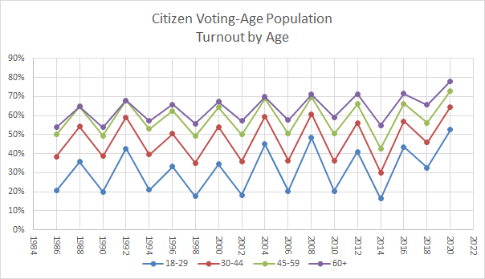
U.S. Citizens: Age & Voter Turnout
QUESTIONS:
Which age group votes more? Why do you think that is?
What trends and patterns do you notice over time?

Slide 7
THE CENSUS
Can numbers tell a story?
YEAR | POPULATION | % INCREASE
2020 | 331,449,281 | 7.4
2010 | 308,745,538 | 9.7
2000 | 281,421,906 | 13.2
1990 | 248,709,873 | 9.8
1980 | 226,542,199 | 11.4
1970 | 203,302,031 | 13.4
1960 | 179,323,175 | 18.5
1950 | 151,325,798 | 14.5
1940 | 132,164,569 | 7.3
1930 | 123,202,624 | 16.2
1920 | 106,021,537 | 15.0
1910 | 92,228,496 | 21.0
1900 | 76,212,168 | 21.0
1890 | 62,979,766 | 25.5
YEAR | POPULATION | % INCREASE
1880 | 50,189,209 | 30.2
1870 | 38,558,371 | 22.6
1860 | 31,443,321 | 35.6
1850 | 23,191,876 | 35.9
1840 | 17,063,353 | 32.7
1830 | 12,860,702 | 33.4
1820 | 9,638,453 | 33.1
1810 | 7,239,881 | 36.4
1800 | 5,308,483 | 35.1
1790 | 3,929,214

Slide 8
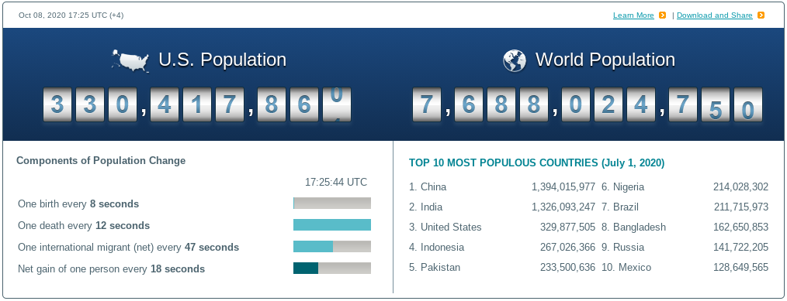
DEMOGRAPHICS
How is America Changing?
Can you name some ways that the population of the United States is changing demographically?
Age
Race and ethnicity
Another factor?
GUESS HOW MANY PEOPLE LIVE IN THE USA!
THEN CHECK YOUR ANSWER ON CENSUS.GOV/POPCLOCK

Slide 9
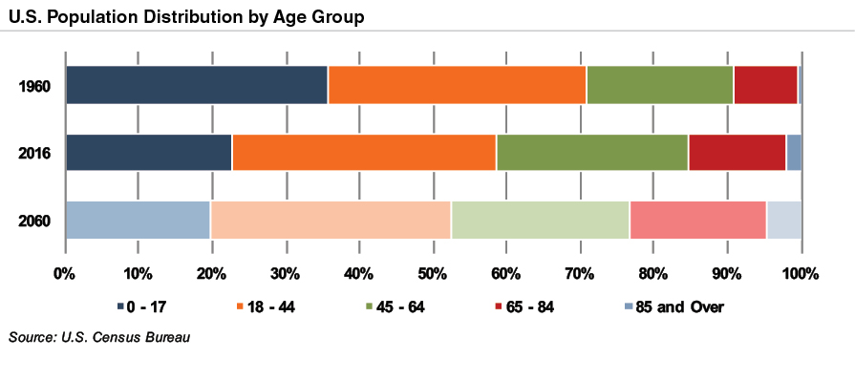
DEMOGRAPHICS
How is America Changing?
BIG TREND:
We’re getting older.

Slide 10
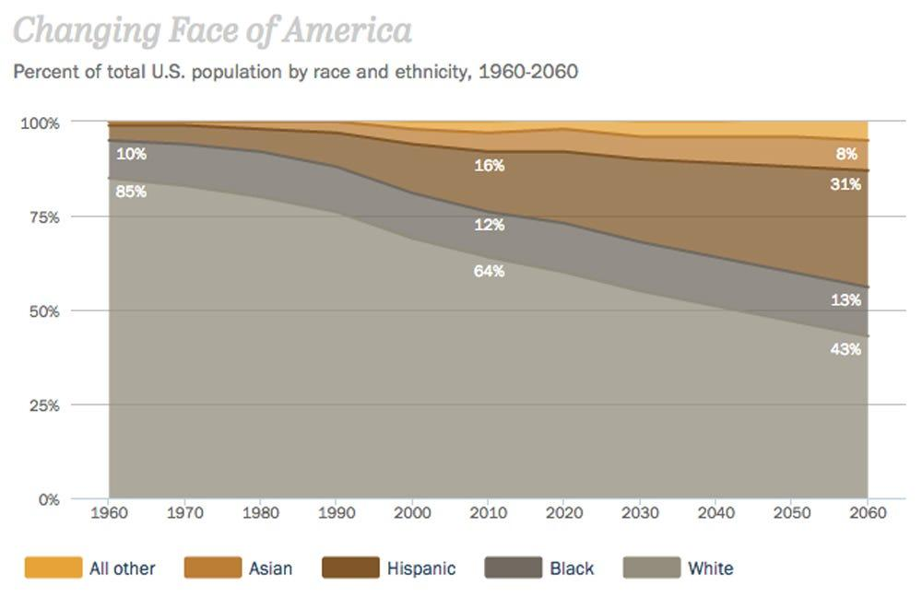
ALL OTHER
ASIAN
HISPANIC
BLACK
WHITE
BIG TREND:
We’re becoming more
racially and ethnically diverse.

Slide 11
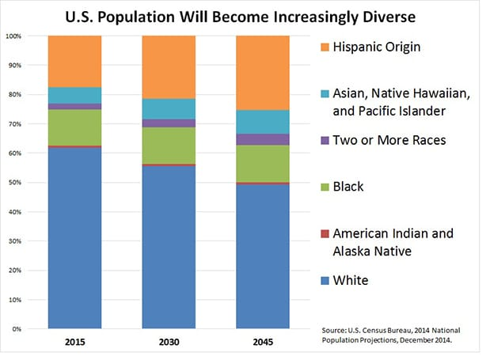

Slide 12
HOW DO
WE USE
THE CENSUS?

Slide 13

The U.S. Census Bureau
ORIGINS
Mandated by the Constitution.
  See Article I, Section 2.
Created by Congress in 1790.
HISTORY
Expanded over time, by Congress.
Today: Part of the U.S. Department of Commerce.
MISSION
Core: Count the population of the U.S.
Also: find out other data about the population.

Slide 14
HOW DO WE USE THE CENSUS?
The main purpose of the Census is to count the population of the United States.
Congress takes that information and uses it for:
GRANTS
  Handing out money to the states.
REAPPORTIONMENT
  Deciding how many representatives will belong to each state.
A. Affects REDISTRICTING.
B. Affects the ELECTORAL COLLEGE.

Slide 15


How Do We Use the Census?
1) Grants.
  The Census counts the population -- and asks about income and other data.
  Congress looks at population and income to decide how much money to hand out to localities, for some kinds of grants.

Slide 16
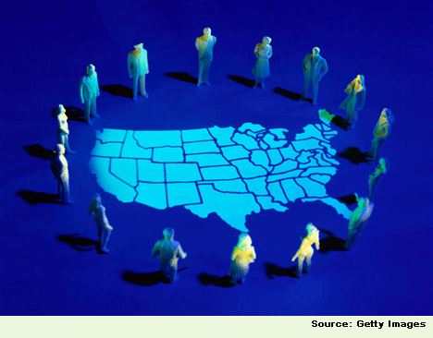
How Do We Use the Census?
2) Reapportionment.
  The Census counts the population.
  Congress looks at population data for each state.
  Congress reapportions the 435 seats in the House -- handing them out to states based on their new populations.

Slide 17

How Do We Use the Census?
2) Reapportionment...
A) ...Affects the Electoral College.
    Congress reapportions the House seats to the states.
    State legislatures now know how many electors they will have in the Electoral College (House seats + 2)
    NOTE: State legislatures make laws that say how
electors are chosen in presidential elections.

Slide 18
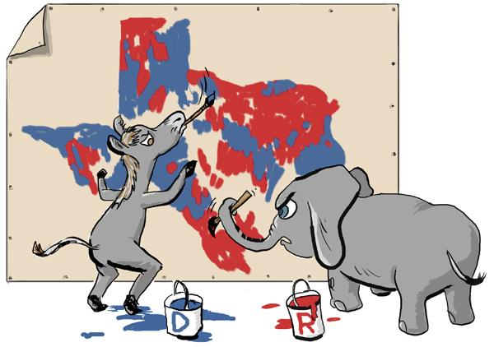
How Do We Use the Census?
2) Reapportionment...
B) ...Affects Redistricting.
    Congress reapportions the House seats to the states.
    State legislatures now know how many U.S. House districts there are in their state.
    State legislatures get to redistrict -- draw new lines that divide their state into congressional districts.

Slide 19
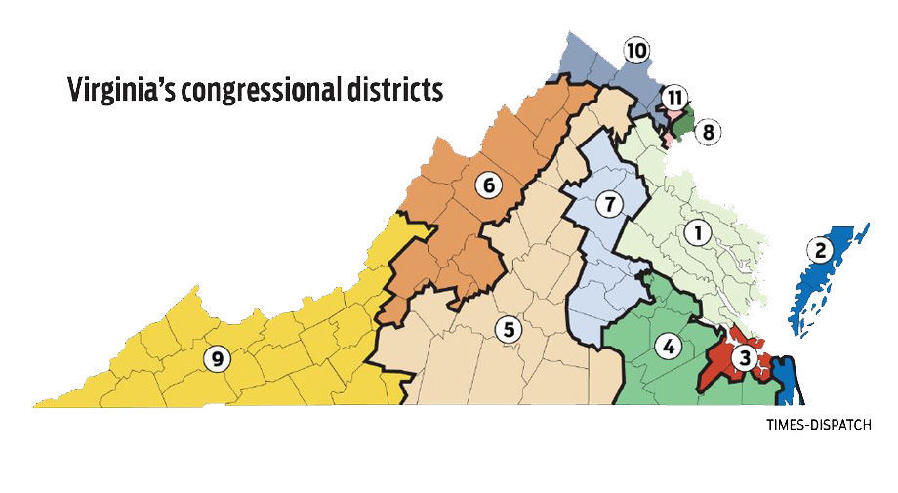
QUESTIONS: U.S. HOUSE DISTRICTS (11)
Where are we? Who represents us?
Why are the 8th and 11th districts so tiny?

