Slide 1
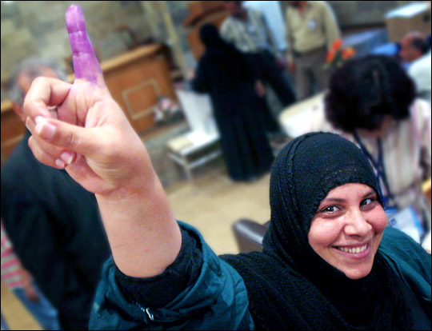
OPENER
What Does Democracy Look Like?
Brainstorm:
What might be happening in this picture?
***
How could it connect to democracy?
We’ll Discuss:
What should we expect from a democracy?
***
How well is the USA doing?
LINKS: Purple fingers.

Slide 2
DEMOCRACY
A Simple Definition
Democracy is:
A system of government
In which the people
Have power, directly or indirectly,
To influence policy.
Democracy is:
A way of running a country
In which citizens
Have control, by voting on laws or leaders,
Over what government does.
NOTE #1:
Definitions have ELEMENTS: essential pieces.
NOTE #2:
But exact words don’t matter as much as
IDEAS.
Etymology Interlude: GREEK
Demos: The people.
Kratia: Rule; power.

Slide 3
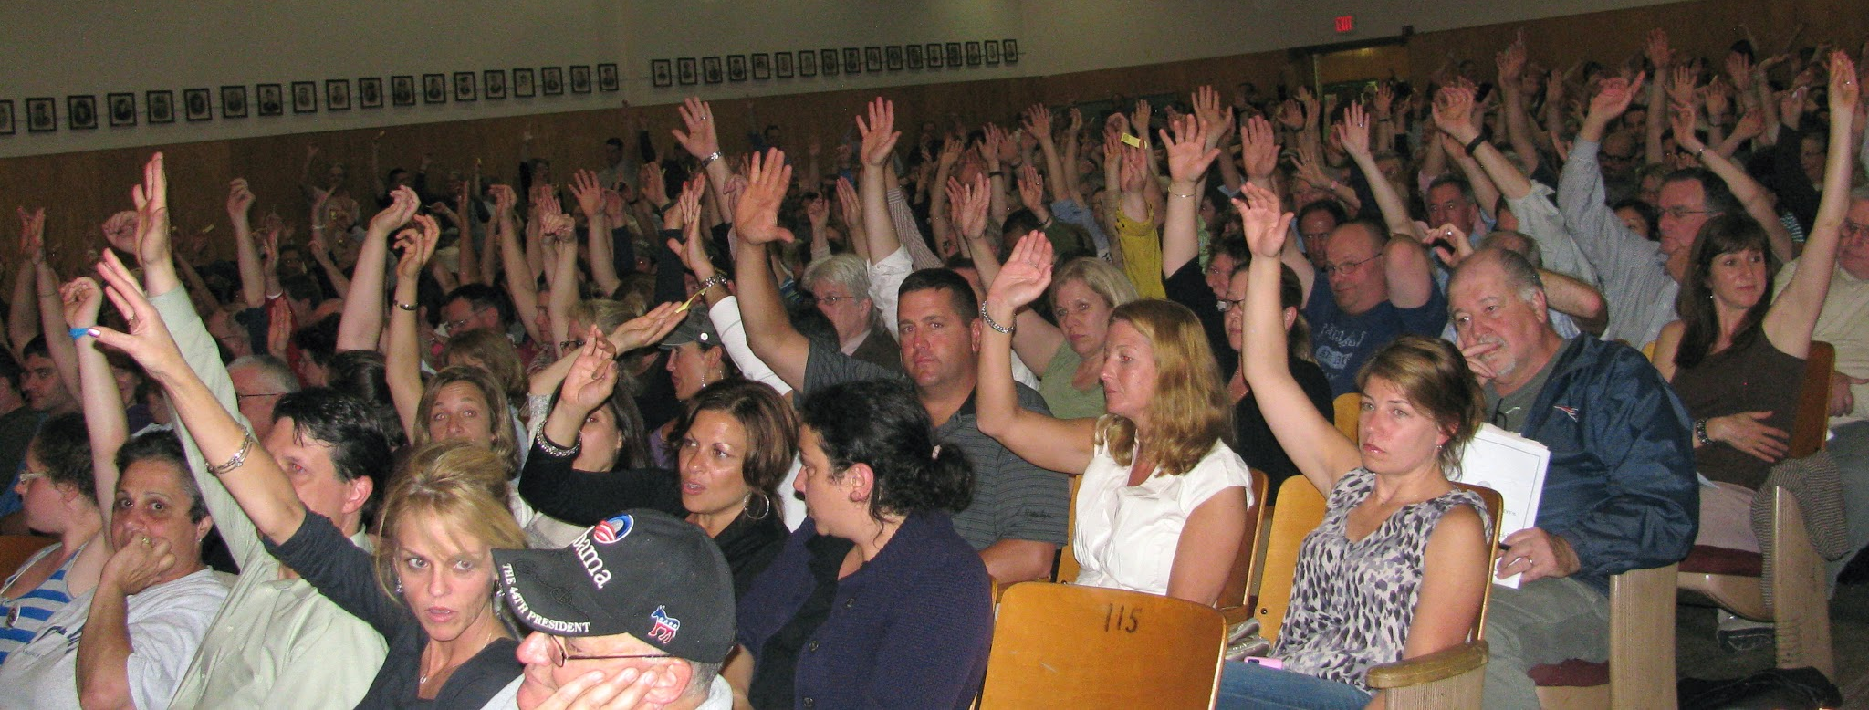
REMEMBER: POLICY
A Simple Definition
Policy (public policy) is:
Official actions
taken by government.

Slide 4
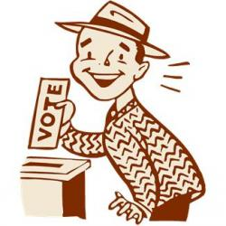

TYPES OF DEMOCRACY
Direct Democracy
Synonym: Pure Democracy
WHAT IS IT?
Citizens vote directly on policy -- like new laws.
WHERE IS IT?
Ancient Athens
Parts of Switzerland
New England town meetings

Slide 5
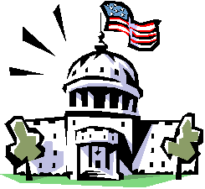
TYPES OF DEMOCRACY
Indirect Democracy
Synonyms: Representative Democracy & Republic
WHAT IS IT?
Citizens choose leaders, who decide on policy for them.
WHERE IS IT?
Nearly all democratic nations (like the USA) practice indirect democracy.

Slide 6
INDIRECT DEMOCRACY
The Legislative Branch
DEMOCRATICALLY
The people vote directly on members of the House and Senate.
CHOOSING LEADERS
Voting happens in every state (for Senate) and district (for House.)
WHO MAKE POLICY FOR US
What can Congress do?

Slide 7
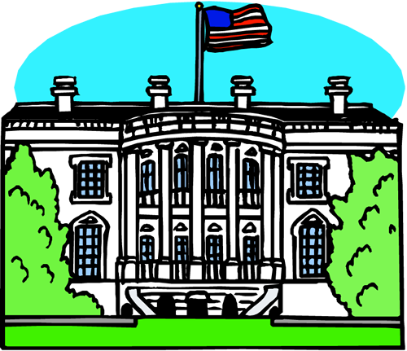
INDIRECT DEMOCRACY
The Executive Branch
DEMOCRATICALLY
The people vote directly for their state legislators. (And their vote for president matters, too, now!)
CHOOSING LEADERS
After popular vote:
State Legislators -> Electors in E.C. ->
President & VP
WHO MAKE POLICY FOR US
What can the President do? Whom can he appoint?

Slide 8

INDIRECT DEMOCRACY
The Judicial Branch
DEMOCRATICALLY
The people vote directly on …
State legislators ->
Electors ->
President
CHOOSING LEADERS
The President nominates judges; the Senate confirms.
WHO MAKE POLICY FOR US
What can the federal courts do?

Slide 9


PAIR UP!
Observing America
> BRAINSTORM TOGETHER:
Imagine you are ambassadors from a far-away galaxy, visiting Earth countries to look for signs of healthy democracy.
Discuss what you’d observe in the USA.
Make two columns in your notes:
  #1: Observations that support
the U.S. being a healthy
democracy, and
  #2: Observations
that undermine that claim.
Write as many as you can!
Tonight’s
DEMOCRACY ARGUMENT
might build on one of these ideas!

Slide 10
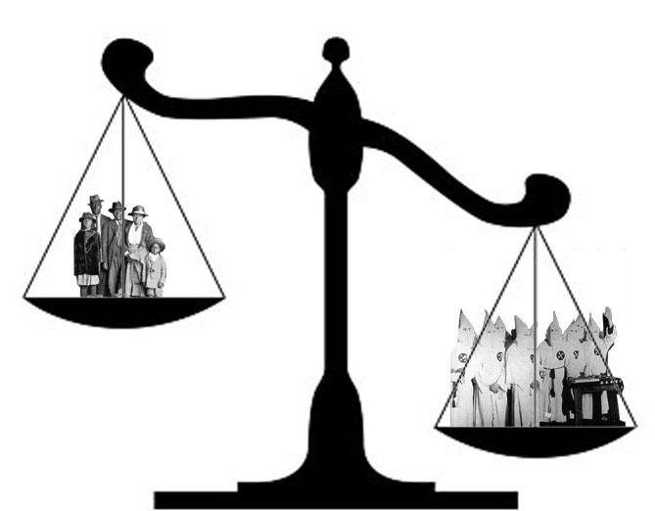
DUELING IDEAS!
The Nature of Democracy
Majority Rule
v.
Minority Rights
How do we follow the will of the people while protecting the liberty of all?

Slide 11

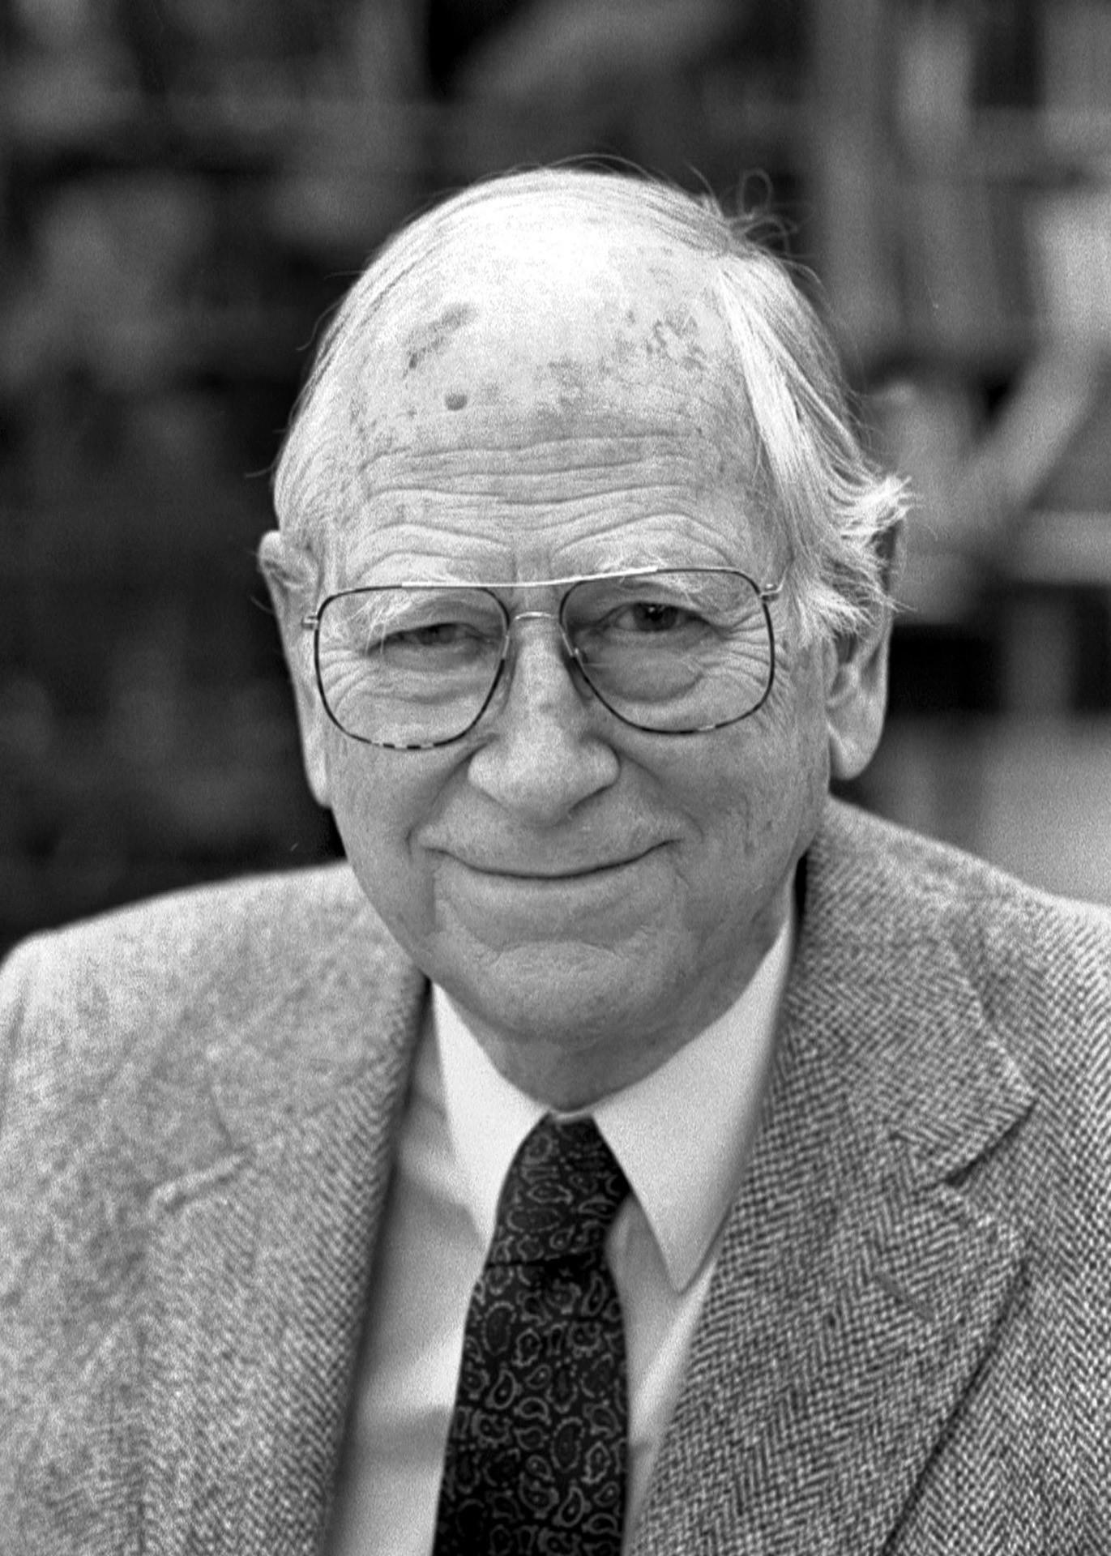
POLITICAL PHILOSOPHY
Elements of Democracy
VIDEO LINK
Majority rule: The will of the people is followed.
Minority rights: But some principles are sacred.
Political scientist Robert Dahl identified five more elements of traditional democratic theory.
Which one did you evaluate for homework?

Slide 12
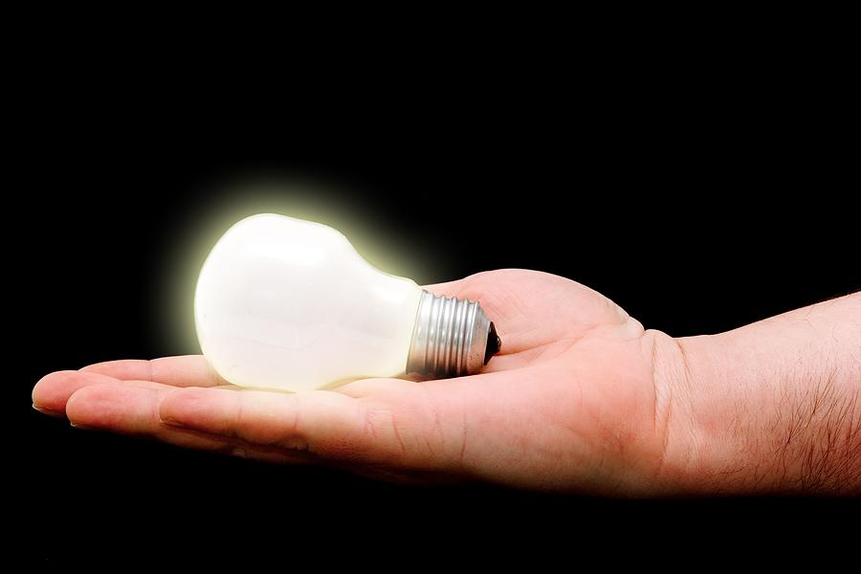
POLITICAL PHILOSOPHY
Elements of Democracy
Enlightened understanding:
Is our country a marketplace
of freely competing ideas?

Slide 13
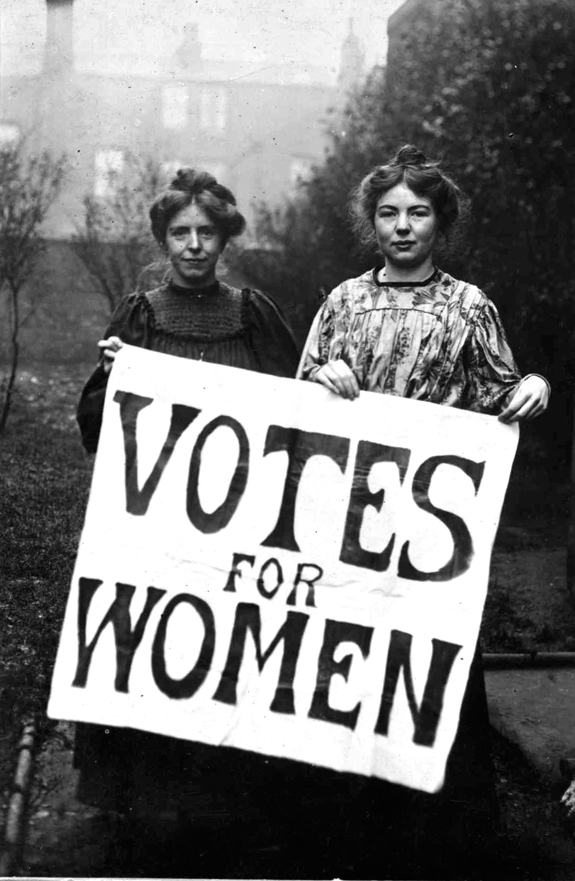
POLITICAL PHILOSOPHY
Elements of Democracy
Inclusion:
Is full citizenship, and its rights, open to all groups who are subject to our laws?
LUCKY LINK:
Constitutional Amendments
(There are 27 in total)
15th, 19th, & 26th
How did these amendments increase the inclusion of our democracy? Do others?

Slide 14
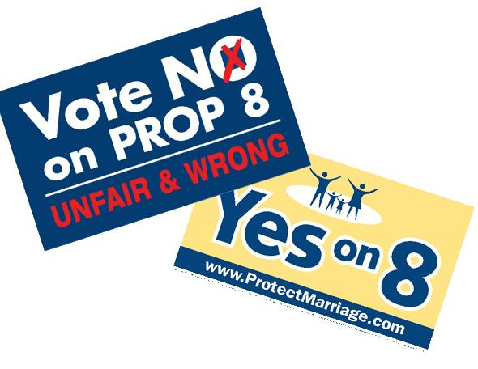
POLITICAL PHILOSOPHY
Elements of Democracy
Citizen control of the agenda:
Are the issues government
focuses on the ones that
people care about?
LUCKY LINK:
Direct Democracy Vocab
(3 ways of giving citizens more control)
Initiative, Referendum, Recall
Can you find examples of these?

Slide 15
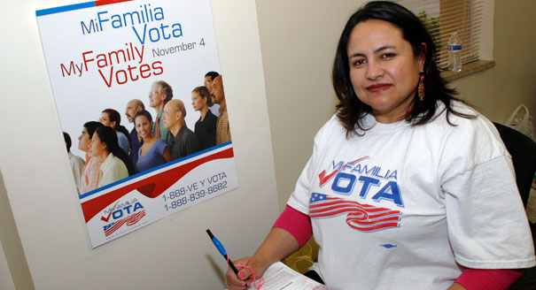
POLITICAL PHILOSOPHY
Elements of Democracy
Effective participation: Are there real opportunities for citizens to influence decision-making?

Slide 16
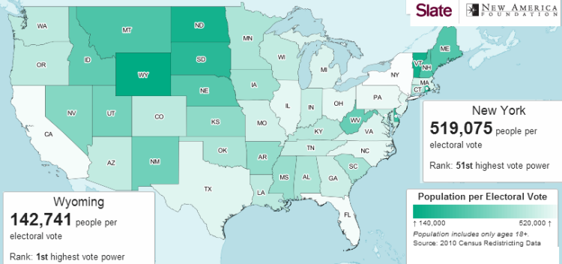
POLITICAL PHILOSOPHY
Elements of Democracy
Equality in voting: Do all votes count the same?
LUCKY LINK:
AP Government Exam
(15 required cases)
BAKER v. CARR
Federal courts can get involved when states have created districts that may be unequal.

