Slide 1
Judicial Review
What is it?
How does it affect me?

Slide 2
"It is emphatically the province and duty of the judicial department to say what the law is."
Chief Justice John Marshall
What do you think this quote means?

Slide 3
Marbury v. Madison
Use the link to watch the video about the case Marbury v. Madison.
  Use this link.

Slide 4
Read the information on the next two slides.

Slide 5
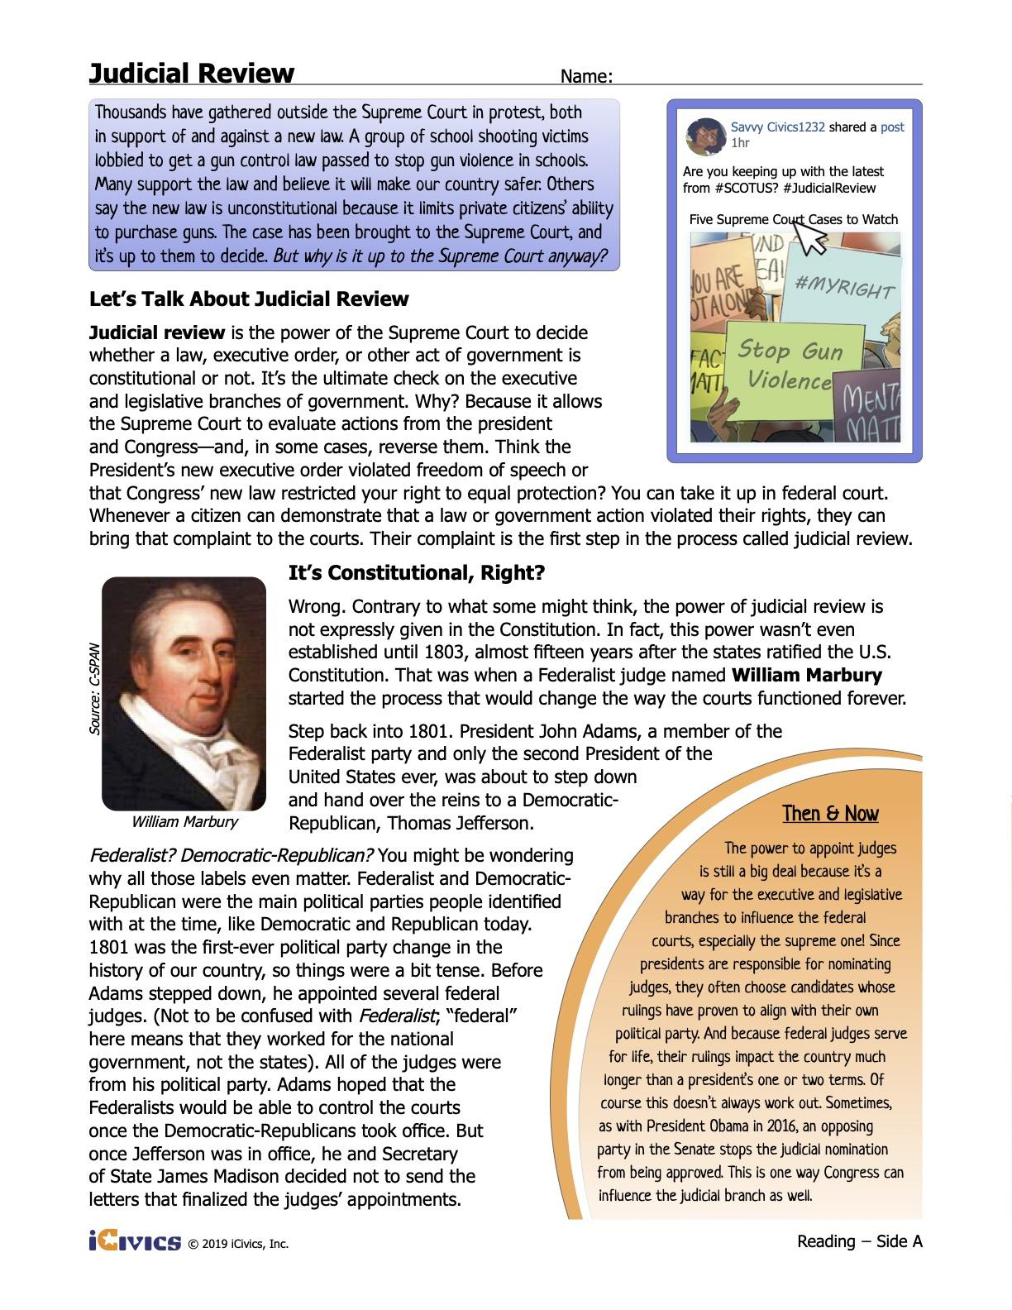

Slide 6
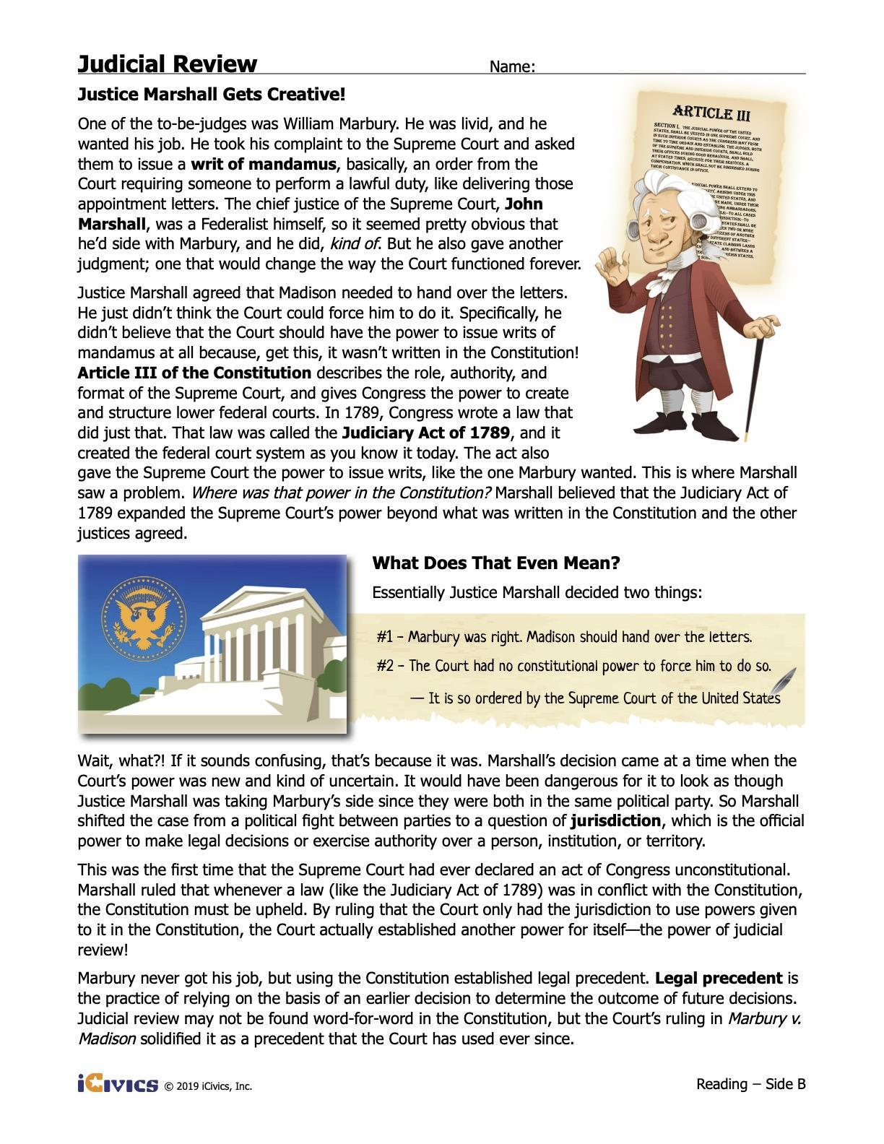

Slide 7
Questions
Directions: After watching the video and reading the article, answer the questions below.
What is judicial review?
What does it give the courts the power to do?
How does judicial review affect our lives?

Slide 8
Impact On Our Lives
On the slides that follow, you will read about three Supreme Court cases from the past.

Slide 9
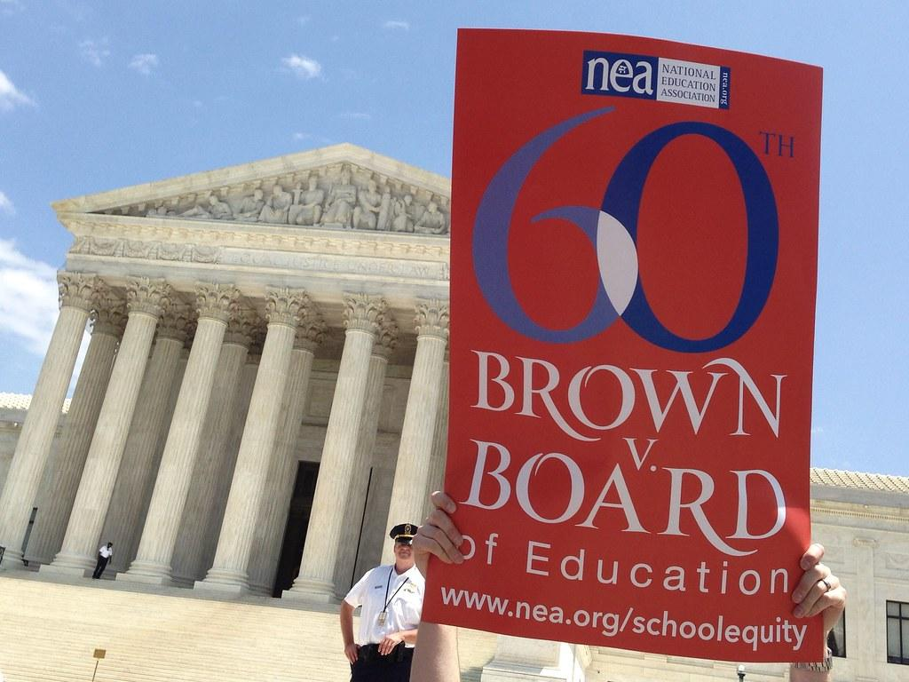
Brown v. Board of Education
Source: https://www.flickr.com/photos/number7cloud/13992154868
Background: In the 1950s segregation laws in many states prohibited African American children and white children from attending the same schools. Linda Brown, an African American girl, could not attend a less-crowded white school a few blocks from her home in Topeka, Kan. Instead, she had to ride a bus across town to attend an African American school. In 1951, Linda Brown’s father and several parents from her school filed suit against the Board of Education of the City of Topeka, Kansas, in the United States District Court for the District of Kansas. He argued that separate schools were unconstitutional because they violated equal protection guaranteed by the Fourteenth Amendment. The district court ruled in favor of the Board of Education citing the “separate but equal” precedent established by the 1896 Supreme Court case Plessy v. Ferguson. The Brown case, along with four other similar segregation cases, was appealed to the United States Supreme Court. Thurgood Marshall, an NAACP attorney, argued the case before the Court.
Source: https://www.uscourts.gov/about-federal-courts/educational-resources/supreme-court-landmarks/brown-v-board-education-podcast

Slide 10
Brown v. Board of Education
Ruling
Source: https://www.flickr.com/photos/number7cloud/13992154868
Decision: Separate but equal educational facilities for racial minorities is inherently unequal, violating the Equal Protection Clause of the Fourteenth Amendment.
Source: https://www.oyez.org/cases/1940-1955/347us483

Slide 11
Questions
Directions: After reading about the case, answer the questions below..
What was the decision in Brown v. Board of Education?
How does this impact what your school looks like today?
If the court would have made an opposite decision, what do you think your school would like today?

Slide 12

Miranda v. Arizona
Source: https://pixabay.com/vectors/arms-arrest-crime-criminal-2029247/
Background: Ernesto Miranda, a Mexican immigrant living in Phoenix, Arizona, was identified in a police lineup by a woman who accused him of kidnapping and raping her. Miranda was arrested and questioned by the police for two hours until he confessed to the crimes. During the interrogation, police did not tell Miranda about his Fifth Amendment protection against self-incrimination or his Sixth Amendment right to an attorney. The case went to trial in an Arizona state court and the prosecutor used the confession as evidence against Miranda, who was convicted and sentenced to 20 to 30 years in prison. Miranda's attorney appealed to the Arizona Supreme Court, which upheld the conviction. Then he appealed to the United States Supreme Court, which agreed to hear it along with four similar cases. In taking the case, the Court had to determine the role police have in protecting the rights of the accused guaranteed by the Fifth and Sixth Amendments.
Source: https://www.uscourts.gov/about-federal-courts/educational-resources/supreme-court-landmarks/miranda-v-arizona-podcast

Slide 13
Miranda v. Arizona
Ruling
Source: https://pixabay.com/vectors/arms-arrest-crime-criminal-2029247/
Ruling: The Fifth Amendment requires that law enforcement officials advise suspects of their right to remain silent and to obtain an attorney during interrogations while in police custody.
Source: https://www.oyez.org/cases/1965/759

Slide 14
Questions
Directions: After reading about the case, answer the questions below.
What was the decision in Miranda v. Arizona?
How does this impact citizens today?
If the court would have made an opposite decision, what do you think arrests would like today?

Slide 15
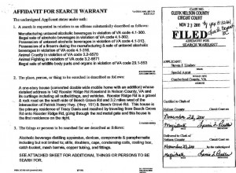
Mapp v. Ohio
Source: https://www.blueridgelife.com/2011/11/28/search-details-of-rooster-ridge-raid-emerge-bear-organs-harvested/
Background: The case originated in Cleveland, Ohio, when police officers forced their way into Dollree Mapp's house without a proper search warrant. Police believed that Mapp was harboring a suspected bomber and demanded entry. No suspect was found, but police discovered a trunk of obscene pictures in Mapp's basement. Mapp was arrested for possessing the pictures and was convicted in an Ohio court. Mapp argued that her Fourth Amendment rights had been violated by the search and eventually took her appeal to United States Supreme Court. At the time of the case, unlawfully seized evidence was banned from use in federal courts but not in state courts.
Source: https://www.uscourts.gov/about-federal-courts/educational-resources/supreme-court-landmarks/mapp-v-ohio-podcast

Slide 16
Mapp v. Ohio
Ruling
Source: https://www.blueridgelife.com/2011/11/28/search-details-of-rooster-ridge-raid-emerge-bear-organs-harvested/
Ruling: The U.S. Supreme Court ruled in a 5-3 vote in favor of Mapp. The high court said evidence seized unlawfully, without a search warrant, could not be used in criminal prosecutions in state courts.
Source: https://www.uscourts.gov/about-federal-courts/educational-resources/supreme-court-landmarks/mapp-v-ohio-podcast

Slide 17
Questions
Directions: After reading about the case, answer the questions below.
What was the decision in Mapp v. Ohio?
How does this impact citizens today?
If the court would have made an opposite decision, what do you think evidence collection would look like today?

