Slide 1
Congress
Overview

Slide 2

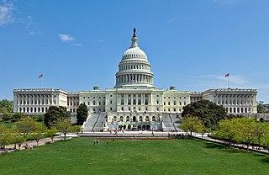
The Legislative Branch
Article I
  Sections 2-3
Congress
  Bicameral
    House of Representatives
    Senate
Notes:
Explain that the legislative branch is found in Article I. Section 1 sets it purpose. Section 2 describes the House. Section 3
describes the Senate. Section 5 lists and explains the powers Congress has.
Congress is bicameral, meaning it has 2 chambers. These chambers are described in the Constitution.

Slide 3


Congress
House of Representatives
  435 members
    Determined by the state’s population.
Senate
  100 members
    Each state has 2 senators regardless of population.
Notes:
*Be sure to explain the population determining number of members- higher populated states have higher numbers of representatives and vice versa.
A good opportunity to examine the compromise that led to this model for Congress.

Slide 4
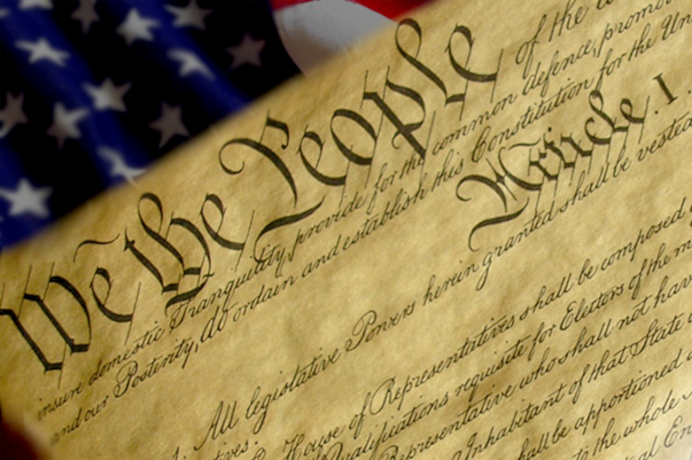
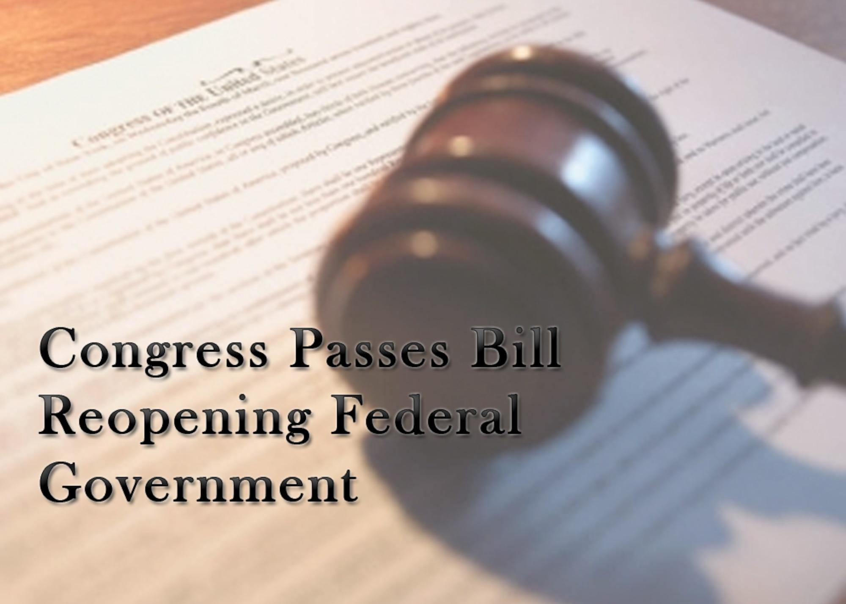
Congress (continued)
Article I
  Section 1
Main/Major Power
  Making Federal laws
Notes:
Section 1 basically explains the reason Congress was created- for legislative powers. The main power that Congress has is to make the laws.
– You can also mention here that you will look more at the lawmaking process later in the lesson.

Slide 5
Types of Power
Expressed Powers
Implied Powers
Notes:
Explain the difference between expressed and implied powers. The last part of section 8 explains the “necessary and proper” part of having implied powers.
You can use a non-Civics example to explain the difference between expressed and implied.

Slide 6


Expressed Powers
Expressed Powers
  Listed in Section 8
    Including (but not limited to):
      collecting taxes, declaring war, establishing post offices, maintaining an army and navy
Notes:
There are other powers not listed on this page. You may discuss or add others to this list.

Slide 7

Implied Powers
Implied Powers
  Listed in Section 8 (at the end)
    “To make all Laws which shall be necessary and proper for carrying into Execution the foregoing Powers, and all other Powers vested by this Constitution in the Government of the United States, or in any Department or Officer thereof.”
Notes:
Explain Implied Powers by using the phrase from the Constitution. It allows for Congressional powers to be stretched, when necessary in order to carry out other powers.

Slide 8
Attributes
Google Slides Template found at:
  https://poweredtemplate.com/04635/0/index.html

